Slide 1

Application:Handy Helper Type: Application Architecture View: Logical View Style: Layered Architecture Pattern
Users
Deliver Channels
Core Business Processes
Data And Information
Technology Enablers
Build profile
Web Sockets
User Account
Customers
User Data
Searching
Email
Web App
Listing
Listing Data
Payment API
Messaging
Booking Data
Booking
Ads API
Helpers
Reviewing

Slide 2

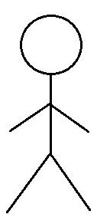
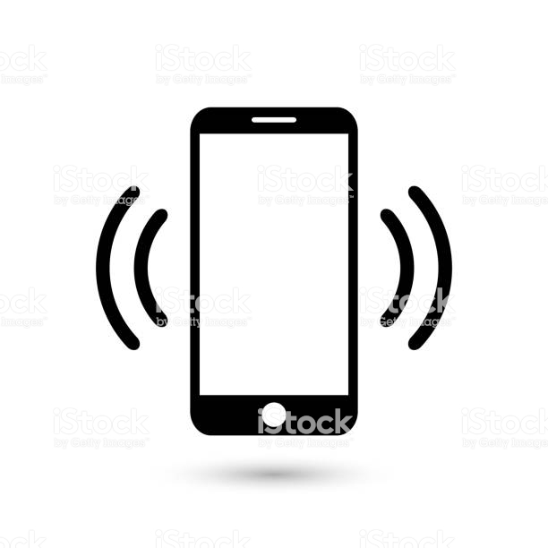
Handy Helper Web Application Type: Application Architecture View: Process View Style: Client-Server Pattern
Web Server
Instances
Database
Instances
DB Instance
Load Balancer
(AWS)
DB Instance
Admin

